Slide 1
Were the Best (at Saving The Planet) and We Know It:
Dominant Brands Benefit From Arrogant Green Advertising
Tyler Milfeld Matthew Pittman
Villanova University University of Tennessee, Knoxville

Slide 2
What is arrogance?
Displaying behaviors that signal superiority over others (Cleary et al. 2015; Senyuz and Hasford 2022)
Arrogance may have positive effects in specific circumstances
Current vs. new customers (Brown 2012)
Relationship formation motive (Senyuz and Hasford 2022)
Luxury brands (Wang, Chow, and Luk 2013)
Arrogance may be persuasive when individuals have a salient relationship motive (Hasford and Senyuz 2020)
Form of comparative advertising
An unexplored arena is brand dominance and arrogance
© Tyler Milfeld and Matthew Pittman | CBR 2022

Slide 3
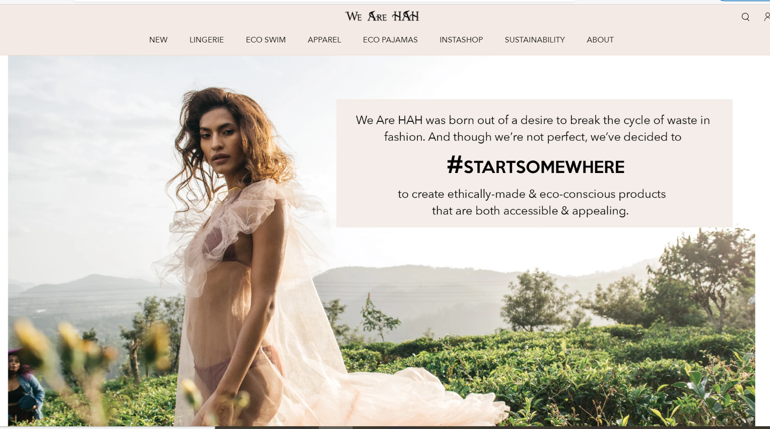
New context – sustainability advertising
© Tyler Milfeld and Matthew Pittman | CBR 2022

Slide 4
Source credibility & signaling theory
Message source is a cue (Morris, Choi, and Ju 2016; Reinhard et al. 2014)
Higher credibility leads to higher purchase intent (Wang and Yang 2010), quality perceptions (Kim and Choi 2012), and confidence in the firm (Kemp and Bui 2011)
Signals become important in asymmetric environments (Erdem and Swait 1998; Saxton et al. 2019)
Brands send signals to reduce asymmetry (Erdem and Swait 1998; Saxton et al. 2019)
Brand dominance may be a viable signal for arrogant message credibility
© Tyler Milfeld and Matthew Pittman | CBR 2022

Slide 5
We propose that consumers may prefer arrogant communication in a specific case…
H1: An arrogant (versus non arrogant) message will generate more (less) favorable brand attitudes when the source is high (low) market share
H2: Source Credibility mediates these effects
Brand dominance
Source credibility
CSR
commitment
Arrogant appeal
Brand attitudes
Solid line indicates a significant effect; dotted line indicates a non-significant effect.
© Tyler Milfeld and Matthew Pittman | CBR 2022

Slide 6
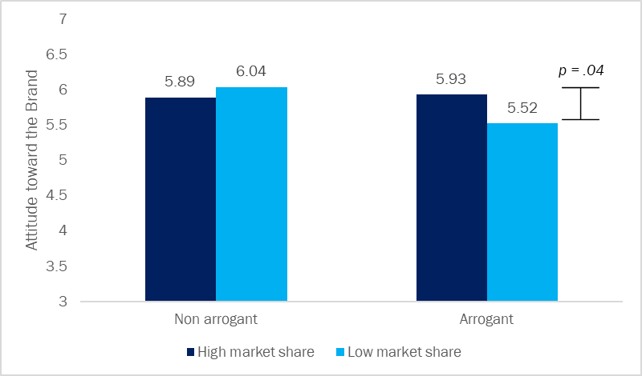
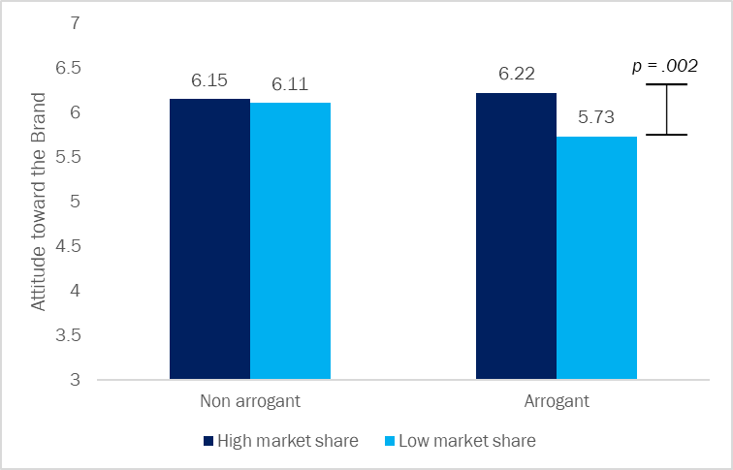
Empirical results
Study 1
Study 2
Two studies reveal that an arrogant appeal enhances brand attitudes when the source is high market share.
© Tyler Milfeld and Matthew Pittman | CBR 2022

Slide 7
Implications & Future Research
Contributions
Future Research
New signal associated with arrogance
Limitation to the non arrogant (humble) communication approach
Brand dominance extends to green advertising
Dominant brands can leverage their market position
Implicit (versus explicit) market share signals
Arrogant messages over time
Real-world choices
What about the little guys?
© Tyler Milfeld and Matthew Pittman | CBR 2022

